Slide 1

C HOICE
Swift
Travel
T R A V E L E R S
T O U R I S T &
An assistant for the discerning traveler

Slide 2
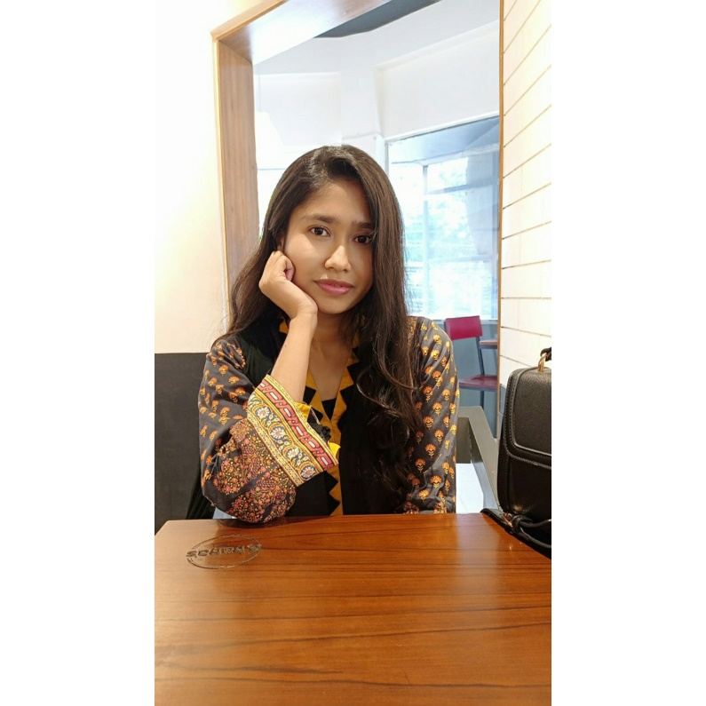


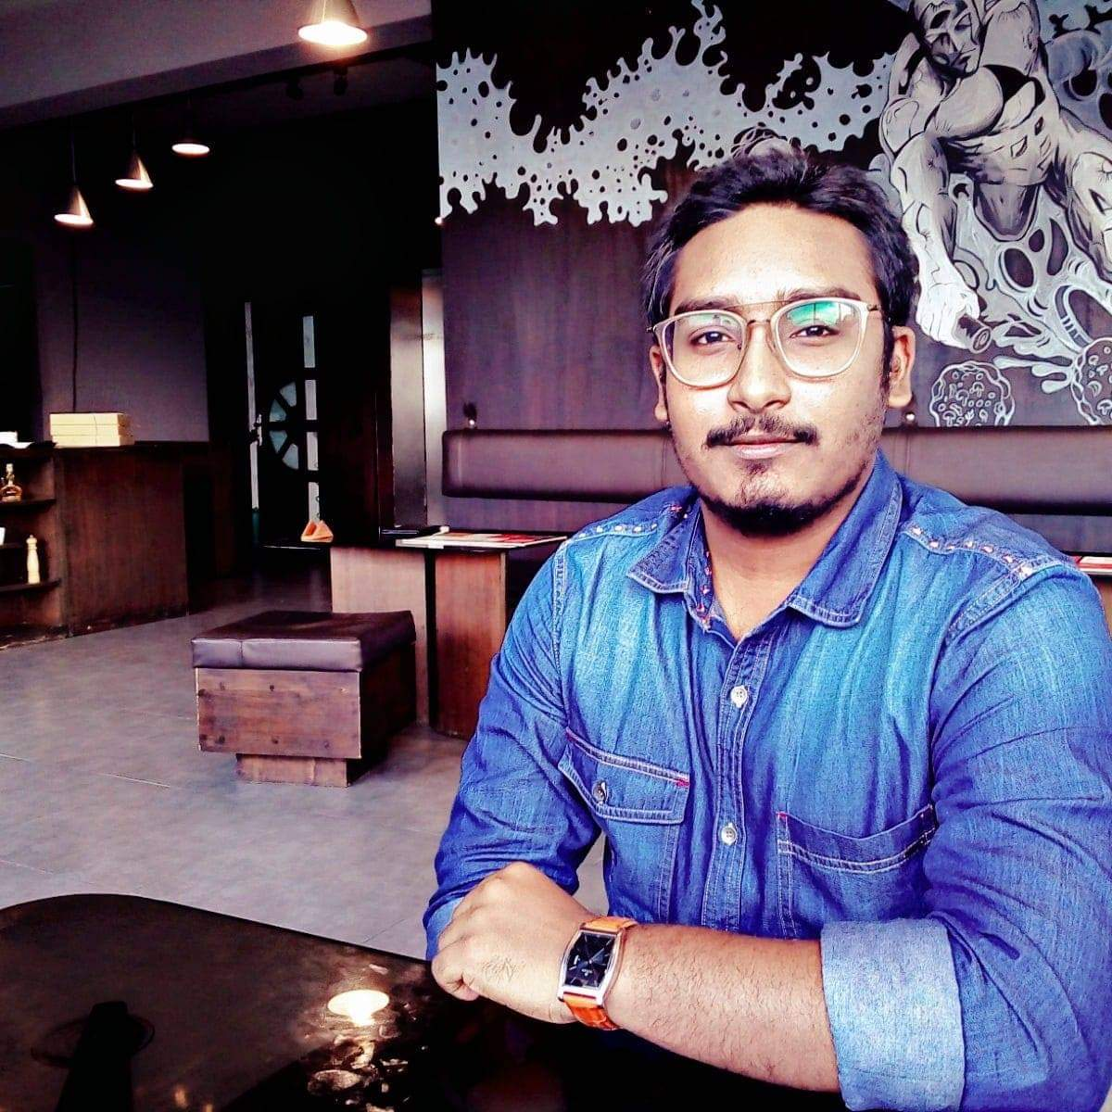
Team Members
DBMS project| Swift Travel
Tasmin Sanjida
Ayeasha Akter
Doha Khan Md.Hedayetur
Mazlish Rahman

Slide 3
Swift Travel
“Travel is the only thing you buy that makes you richer” – Anonymous
Going on a trip is always exciting ! Isn’t it? But with that excitements comes a little trouble of deciding the destination, finding a suitable place to stay, ticket booking, what to do and many things… And, sometimes you might have even cancel the trip just about thinking all these problems!
That’s why we have come with “Swift Travel’’ that will work as your own tour manager and makes you tour successful while reducing all the hazards.

Slide 4
Features of
Swift Travel
Profile Creation
Tourist Spot
Description, Specification & Pictures
Hotel Management
Room booking accordingly
Ticket Booking
Book the ticket accordingly.
Swift
Travel

Slide 5
Features of
Rental Car
Rent a car if you asked
Things To Do
A list of things you can do on that specific place
Guide
To help you and make your trip more memorable
Packing Tips
Get the packing tips accordingly
Swift Travel
Swift
Travel

Slide 6
Unique features of Swift Travel
Trip Designer
Exclusively design a trip according to your choice.
Travel Insurance
Get refund accordingly… so NO worries!
Estimated Bills
Get to know about estimated bills accordingly

Slide 7
Working Schedule
1st week:
User profile, Tourist spot, Things to do, Hotel management
2ns week:
Ticket booking, Rental car, Estimated bills
3rd week:
Travel insurance, Trip designer, packing tips
Frontend work: Ayeasha Akter, Md. Hedayetur Rahman
Backend work: Tasmin Sanjida, Doha khan Mazhlish
Swift
Travel

Slide 8
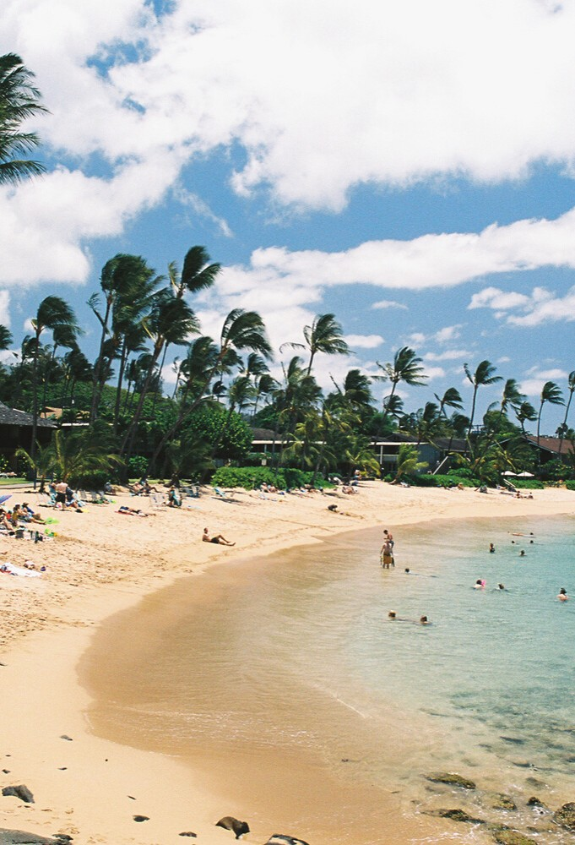
Thank you!
Assalamualaikum

